Slide 1
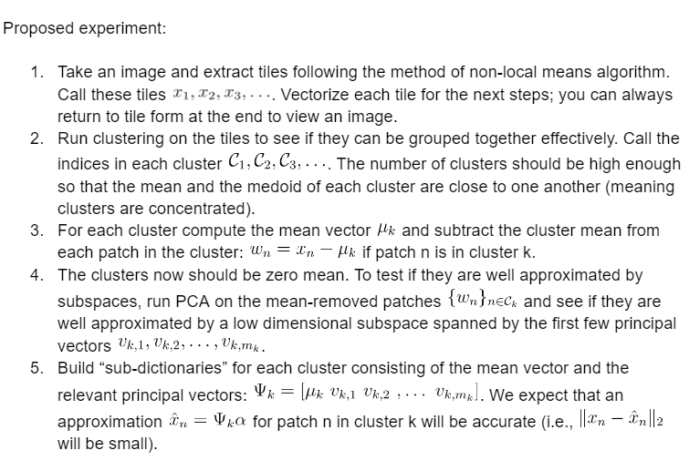
Trial 1: The Approach from our explorations

Slide 2
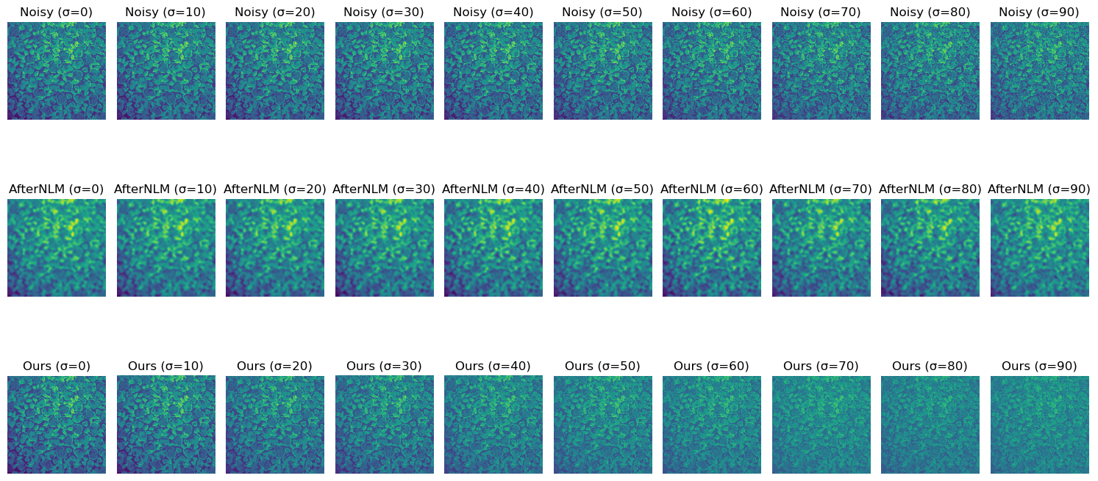
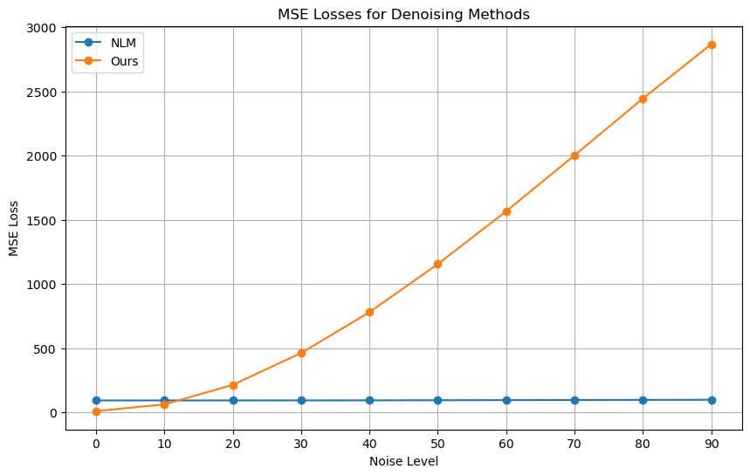
Hyperparameters:
Patch size =8x8 => dimensionality of a vector =64
Number of clusters = 20
The top 50% of PCA vectors were chosen from each cluster
Gaussian noise added at ten scales of sigma [0,10,... 90] for image pixel range[0,255]
Results Comparison with NLM (slow version of scipy):
H parameter = 0.7
Sigma_est is used

Slide 3
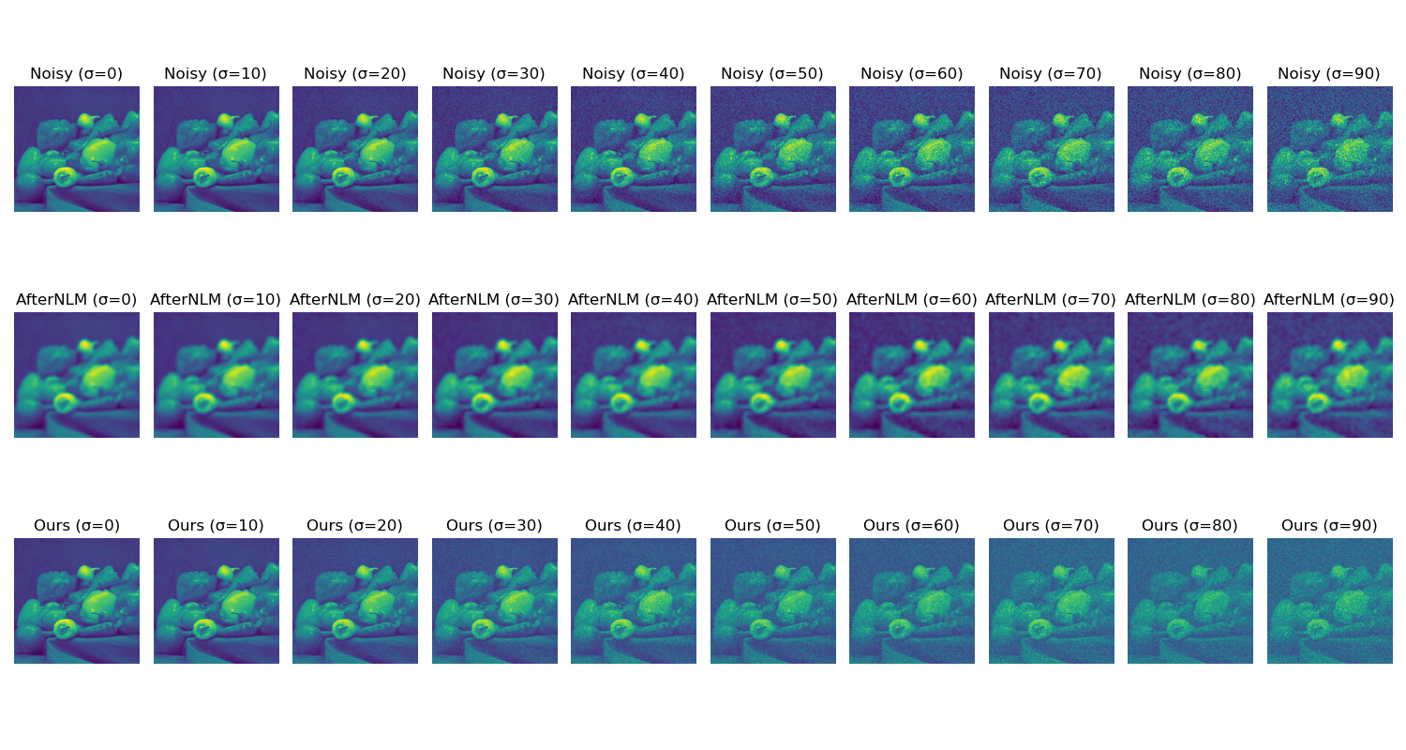
Image 1

Slide 4
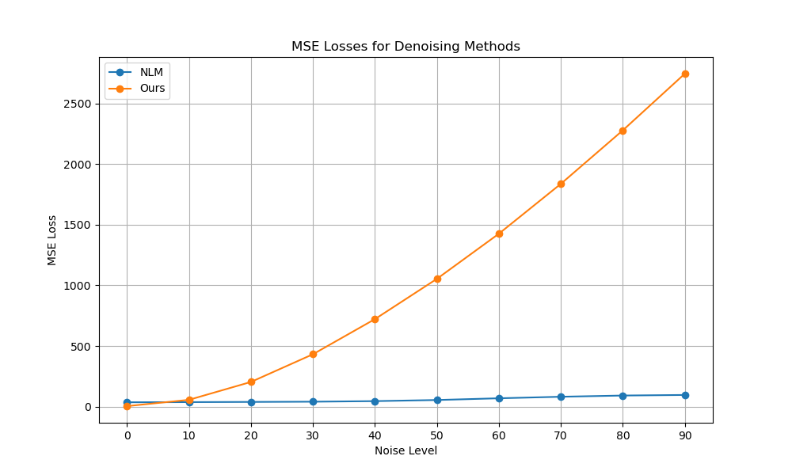
Image 1

Slide 5
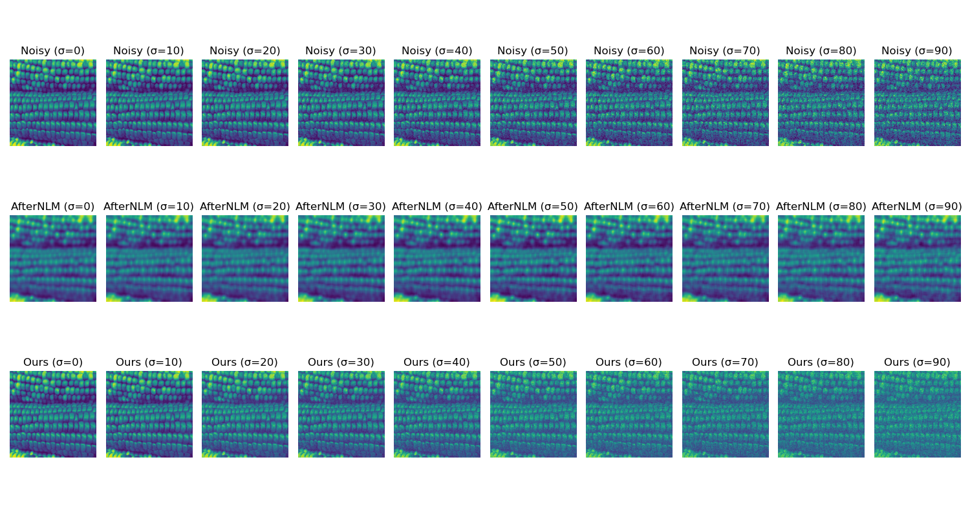
Image 2

Slide 6
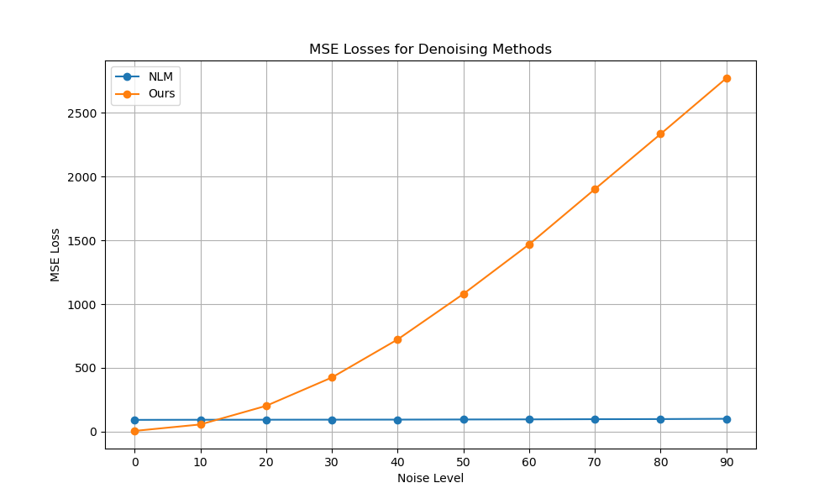
Image 2

Slide 7
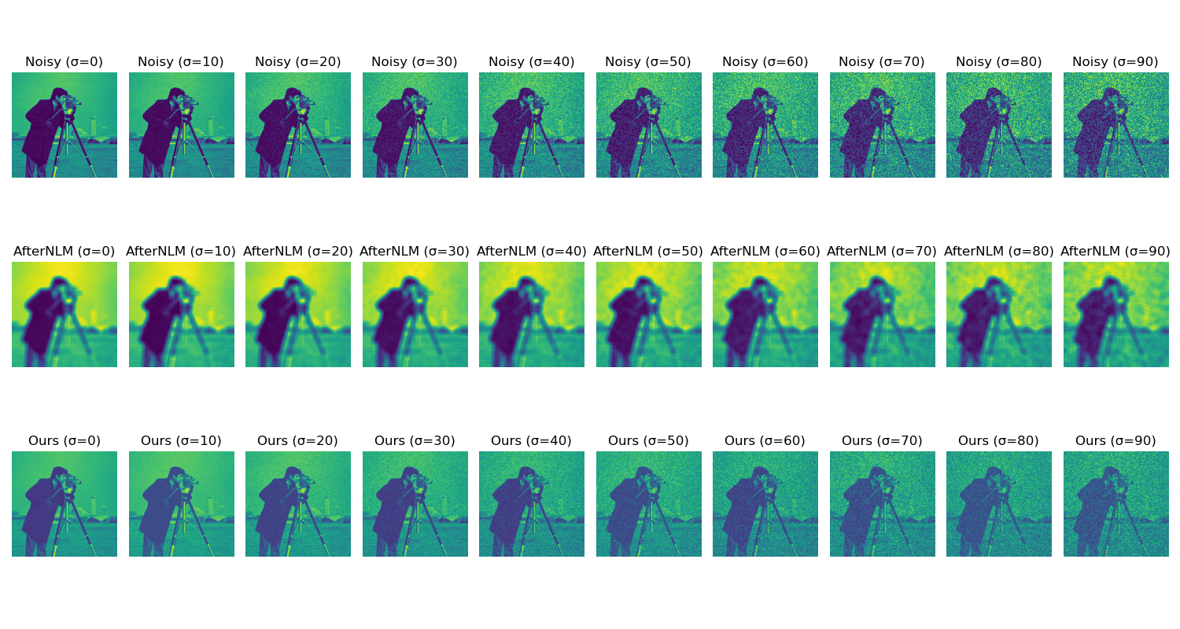
Image 3

Slide 8
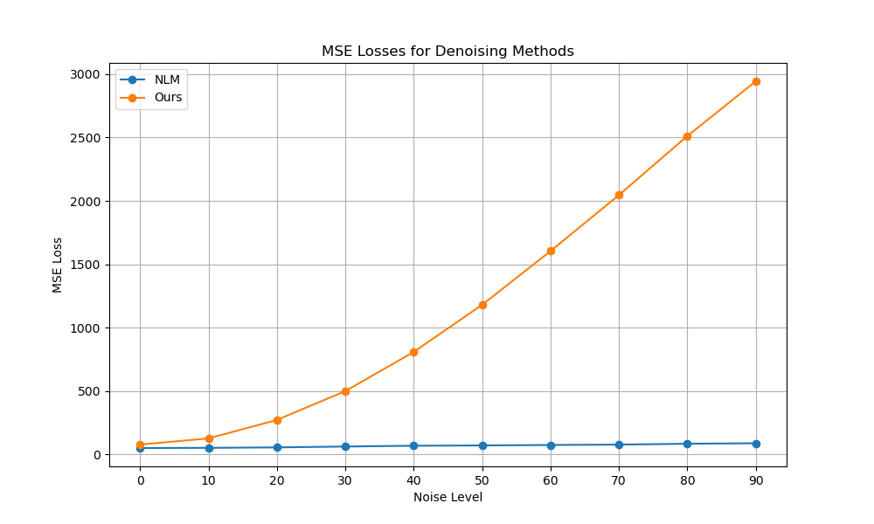
Image 3

Slide 9
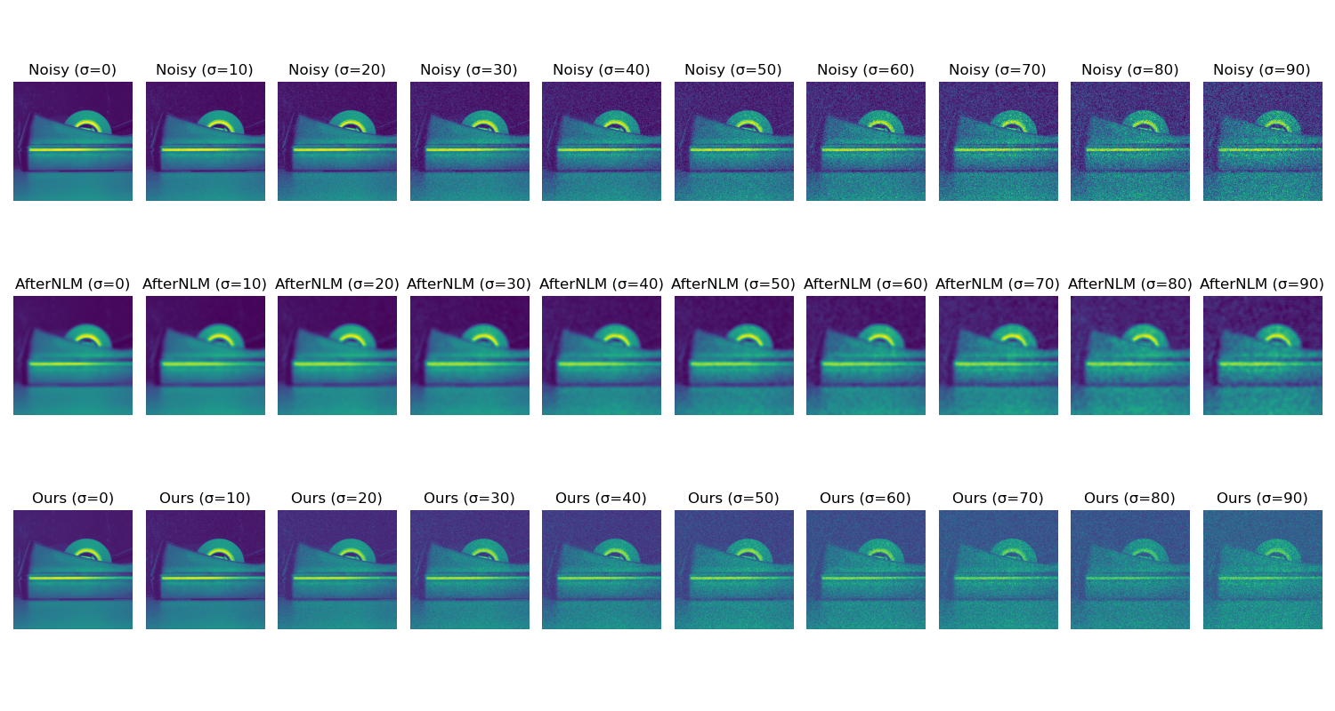
Image 9

Slide 10
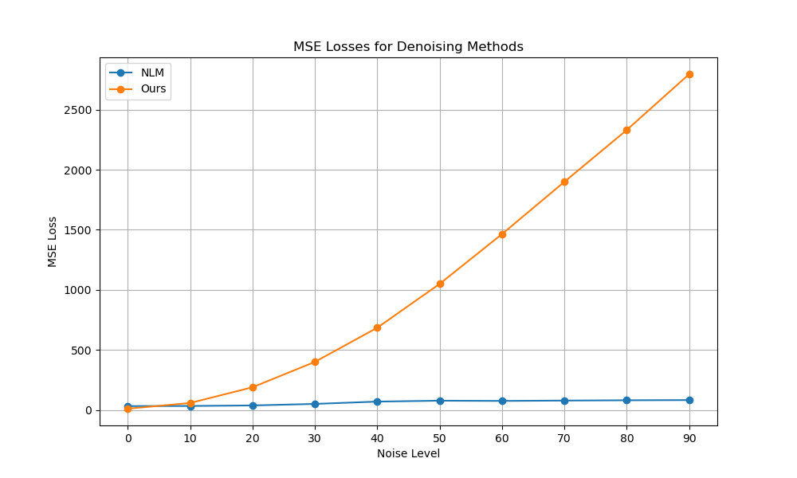
Image 9

Slide 11
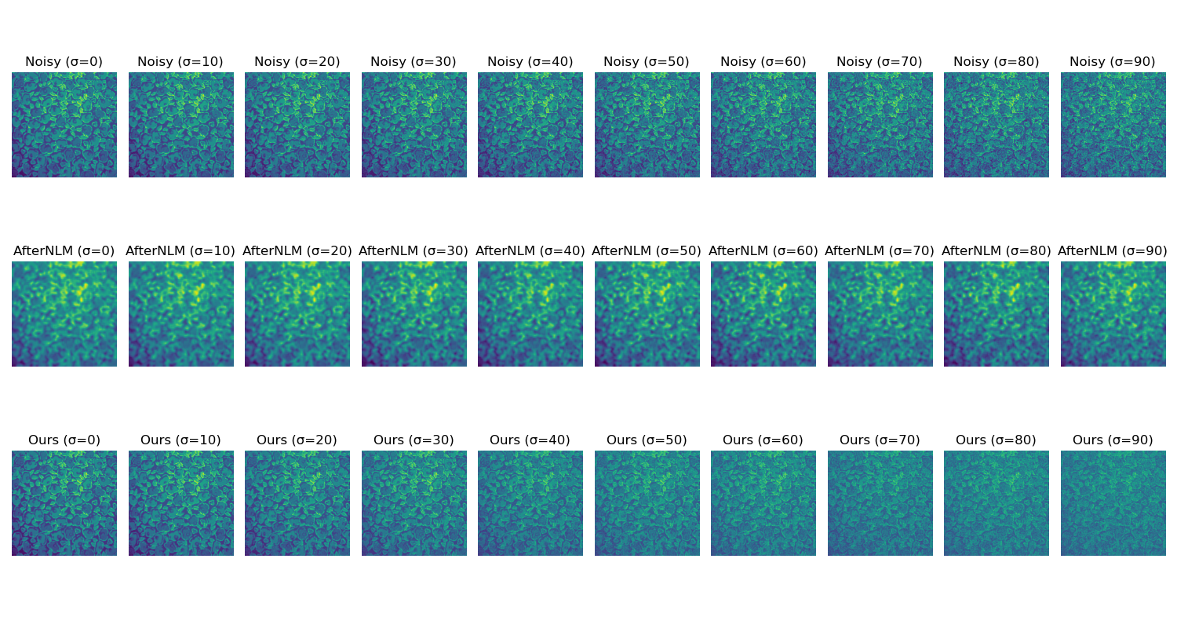
Image 10

Slide 12
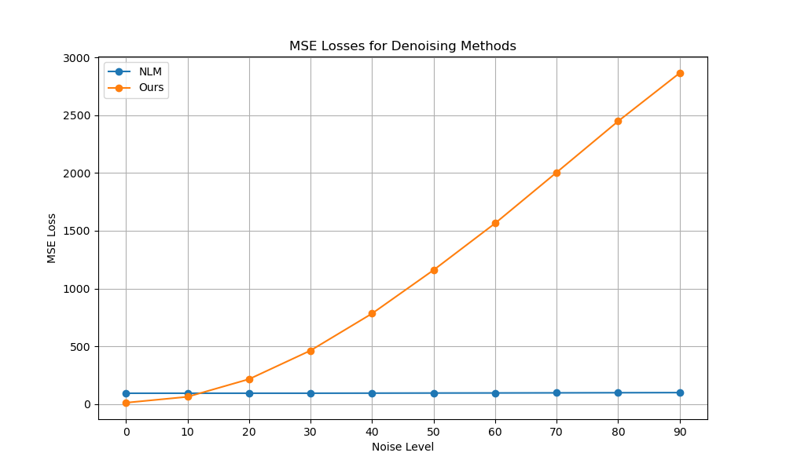
Image 10

Slide 13

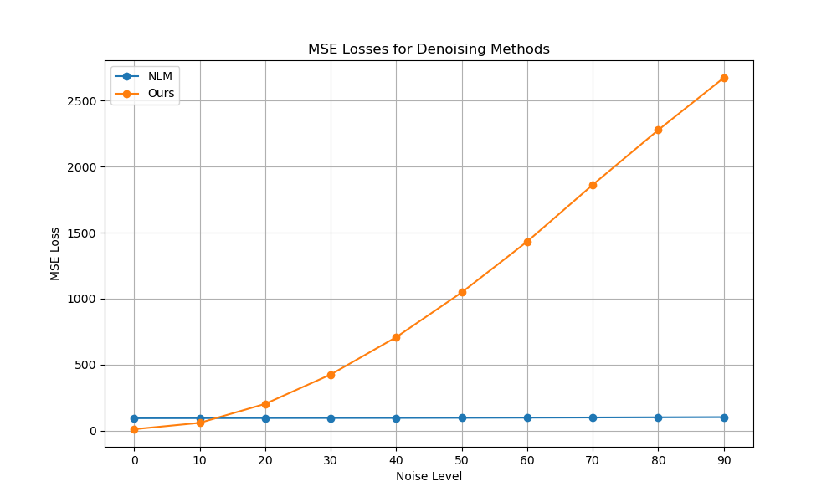
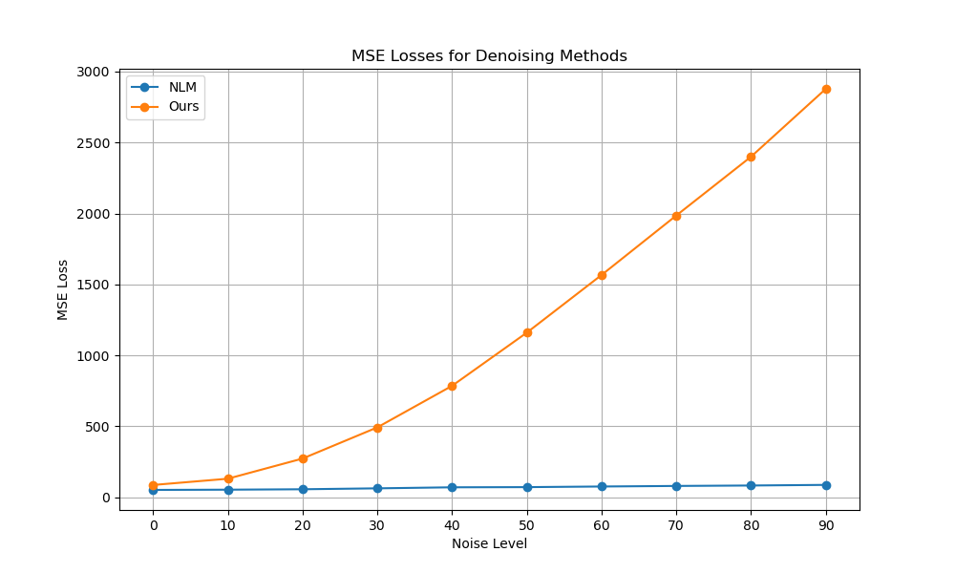
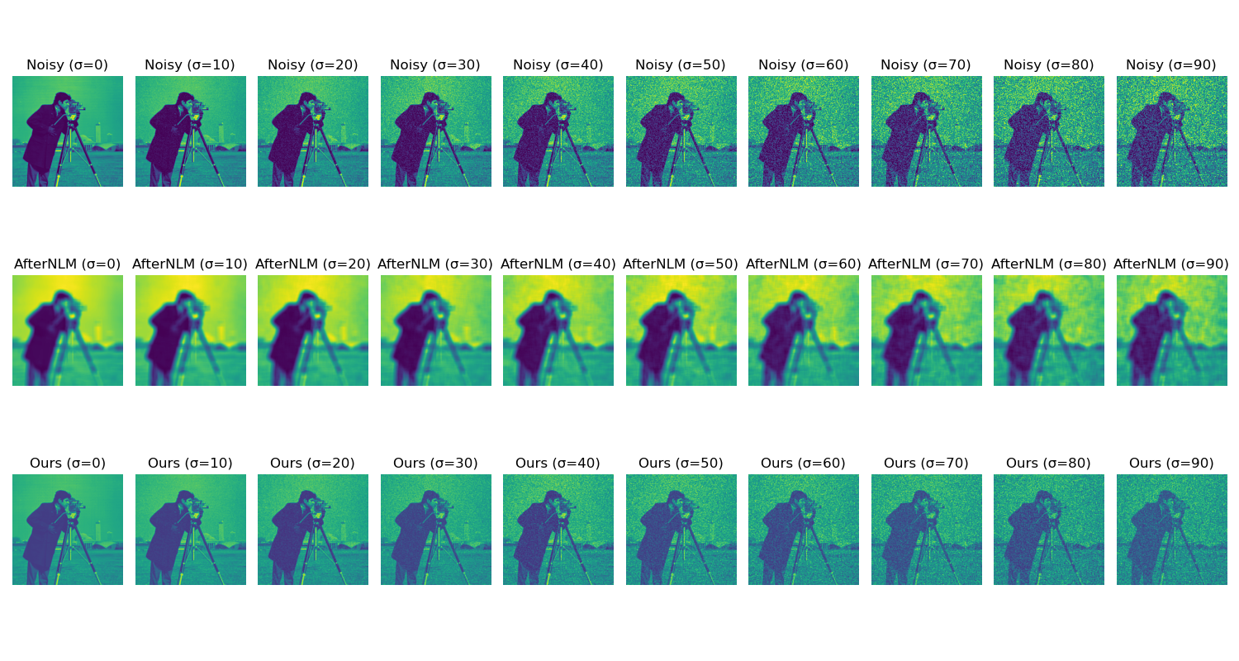
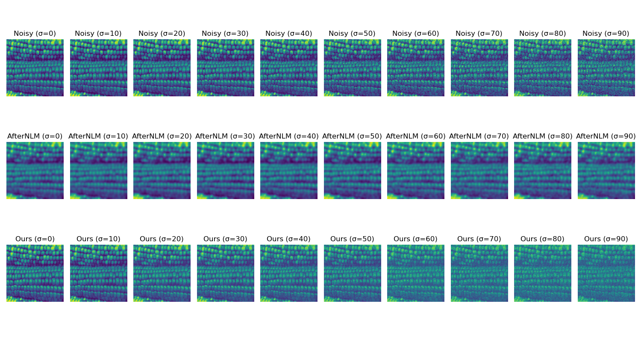
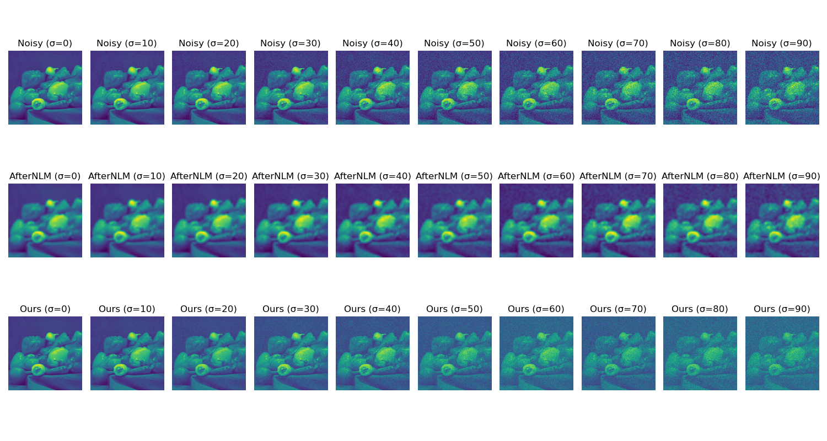
Tried the version 2: remove the mean from the data, and add it back after projection. Same results :C

Slide 14
May week 1: Trying different clustering algorithms

Slide 15
Robust Subspace Clustering: Sankoltanabi, Candes 2014 (My code)
Robust Subspace Clustering: Sankoltanabi, Candes 2014
Some relaxations, such as not requiring (\beta.T 1) =1
(My code)
Each vector (out of 3600 is used to get \beta_i in a for loop)
Takes ?inf? hours to run the (3600,64) data vector
Need to find a better[faster] version:
Takes 20 hours to run the (3600,64) data vector
Need to find a better[faster] version:

Slide 16
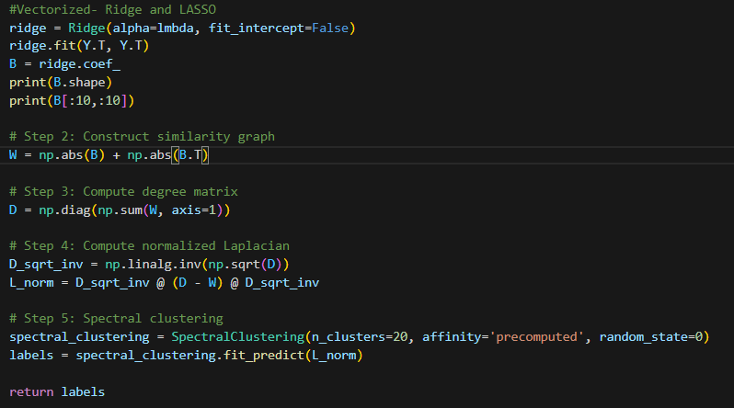
LASSO regression with no constraints on \beta to get the regression coefficients: My attempt
Ridge regression with no constraints on \beta to get the regression coefficients: My attempt
Takes 17 minutes to find B
Hits infs/NaN errors when trying to find Lnorm
Takes instantly finds B
Hits infs/NaN errors when trying to find Lnorm

Slide 17
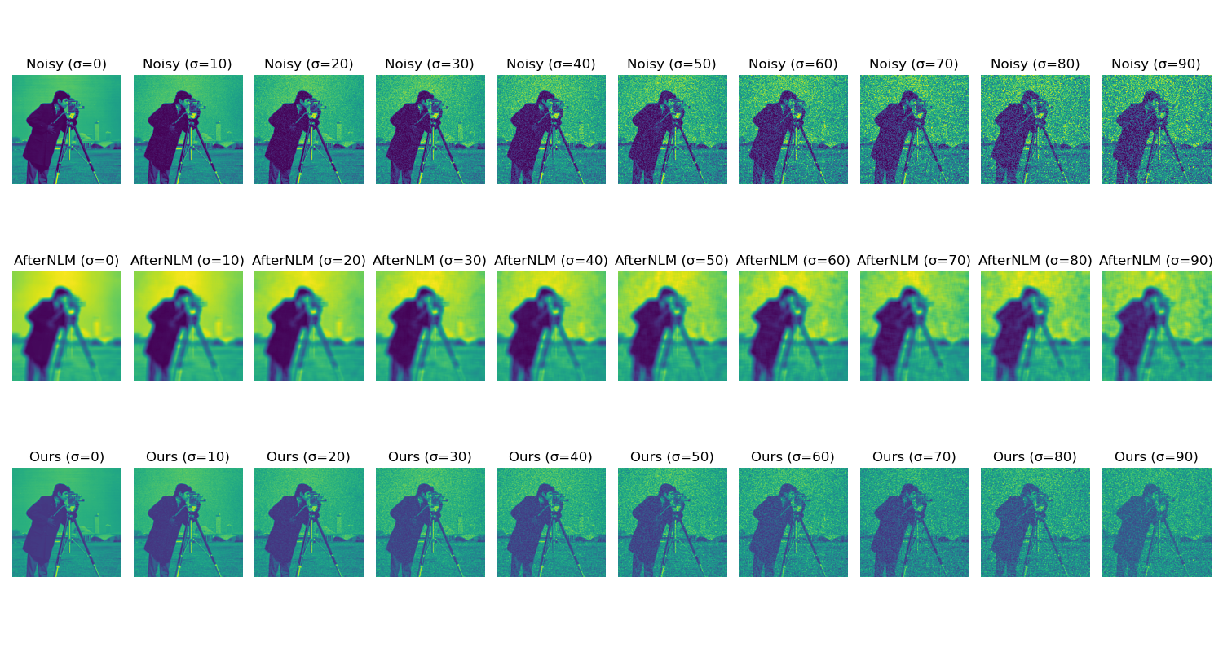
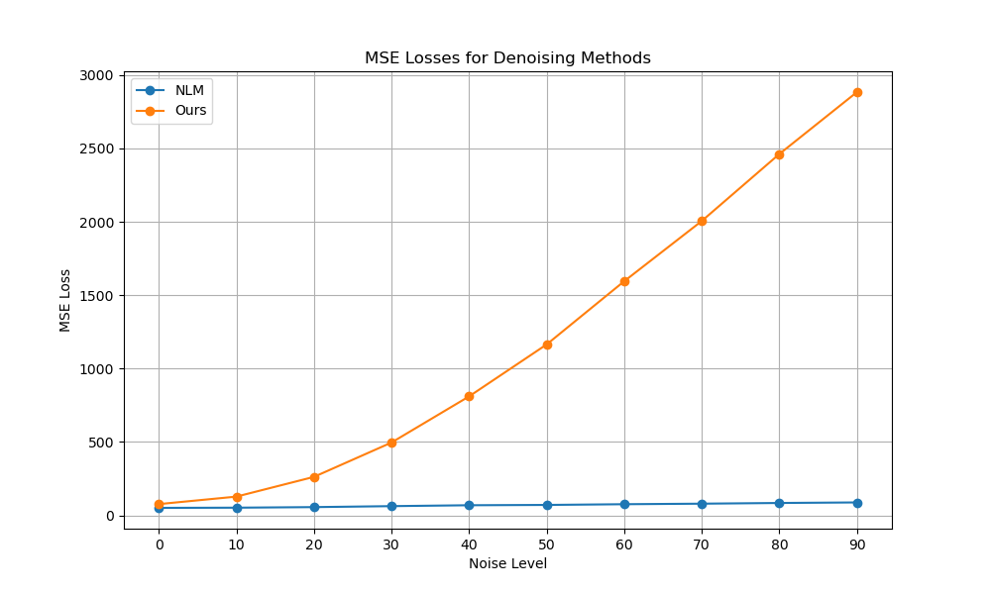
Spectral Clustering from Scikit learn: The “Graph” is the data matrix- which is gross estimation.
Warning: Graph is disconnected
No improvement to the previous slides (e.g:12,13)

Slide 18
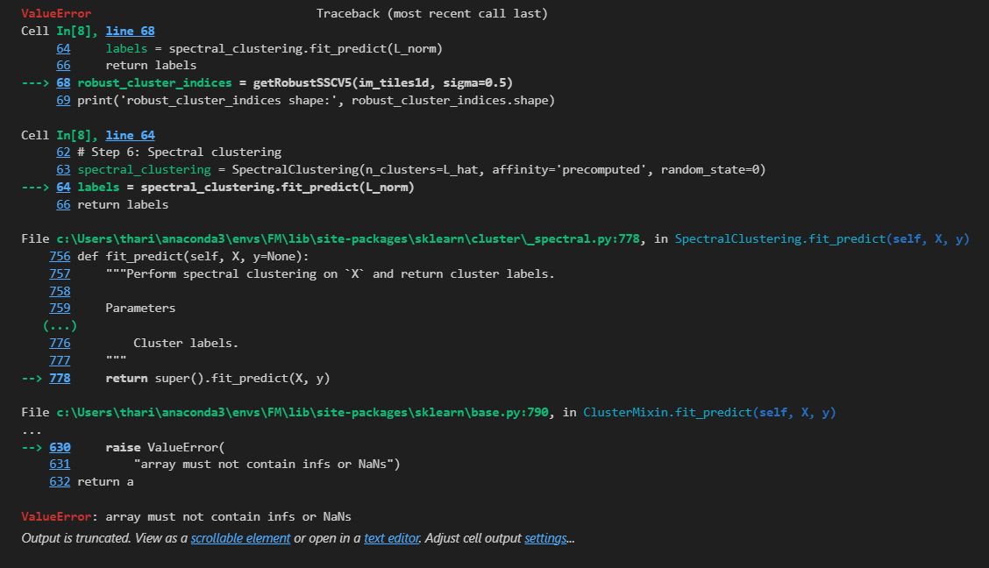
Indirectly enforcing beta_i = 0 for each beta.
Run BPDN for N-1 dimensional beta.
Takes 1+ hour for 1 \beta_i , and days to find B
With the cr_sparse, B is found in 35min
Still, NAN/inf appears when trying to find

Slide 19
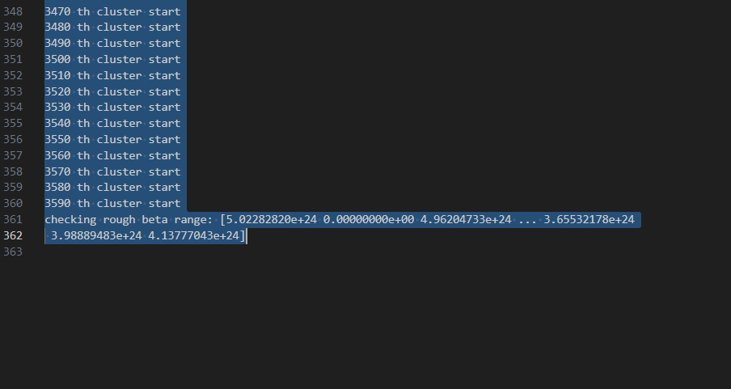
So L_norm having Infs/NANs ⇒ The Inversion step should have some problem
Diagonal zeros with all other elements very high values?

Slide 20
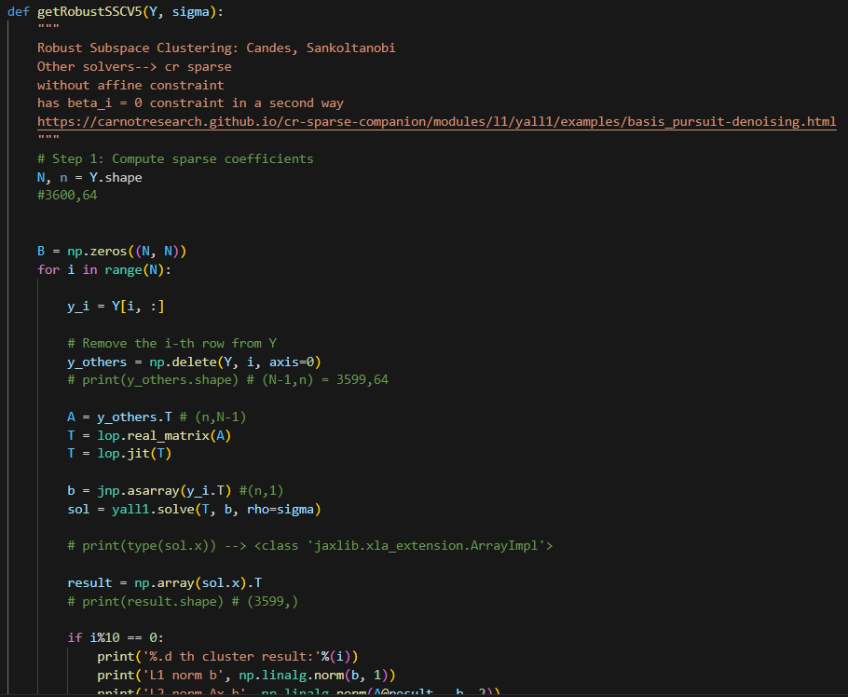
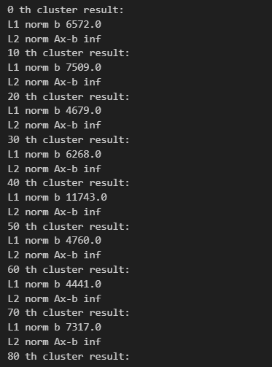
Checked the magnitudes (Ax-b) and |x| to see if the optimizer works
The yall1 solver is not optimizing anything.

Slide 21
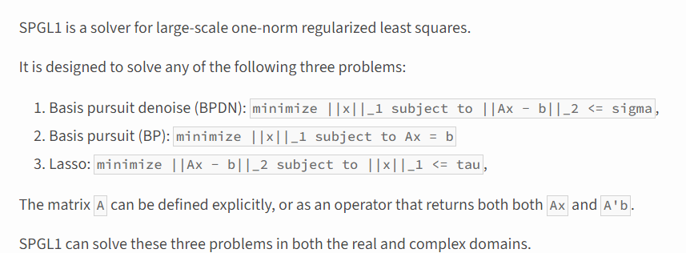
Tried the spgl1 solver:
BP, BPDN
https://pypi.org/project/spgl1/
https://friedlander.io/spgl1/
https://spgl1.readthedocs.io/en/latest/api/generated/spgl1.spgl1.html
https://spgl1.readthedocs.io/en/latest/tutorials/spgl1.html#sphx-glr-tutorials-spgl1-py
Just solving for the BP does not give an answer. The SPGL1 algorithm does not find a BP solution until iter max is reached
Tried BPDN algorithm with sigma=1 ⇒ No BPDN solution within itermax
Tried BPDN algorithm with sigma =100 => BPDN suboptimal solutions found.

Slide 22
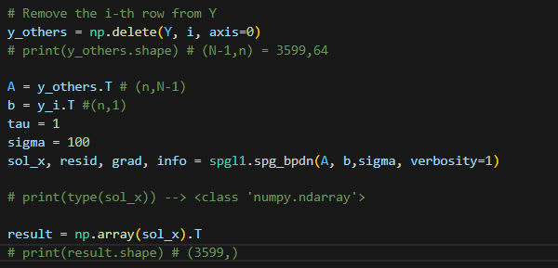
Using BPDN with the sigma=100

Slide 23
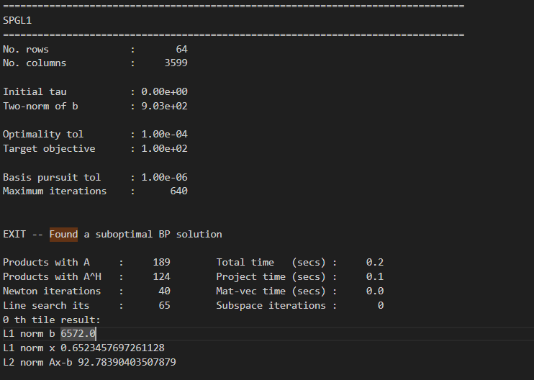

Slide 24
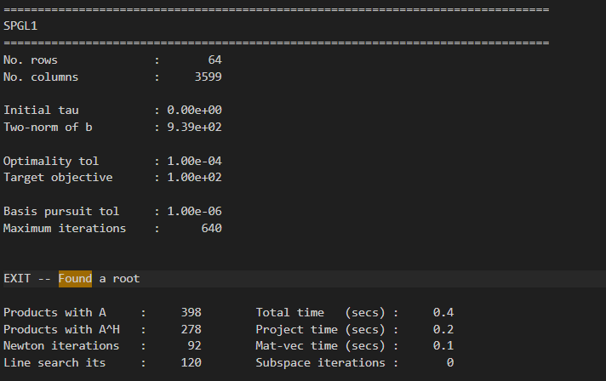
2763 blocks (out of 3600) found a root in the sparse regression.

Slide 25
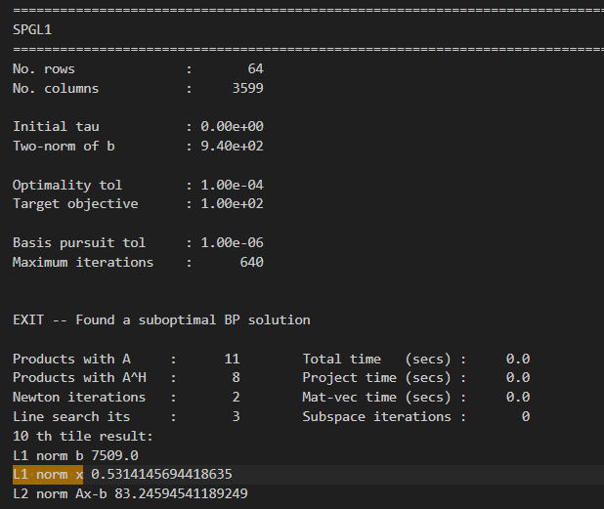
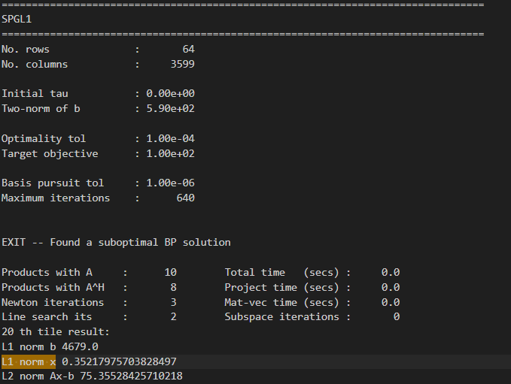
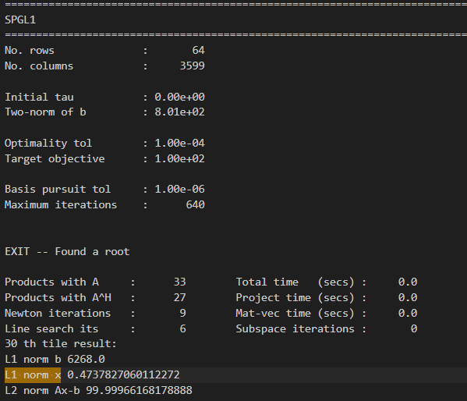


Slide 26
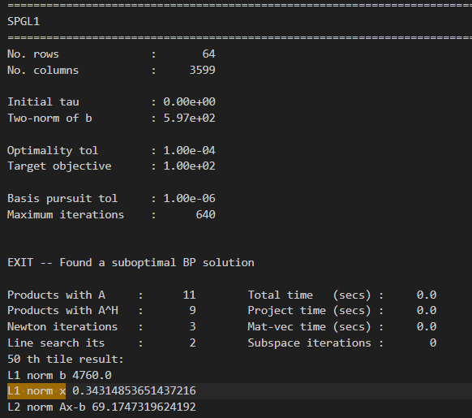
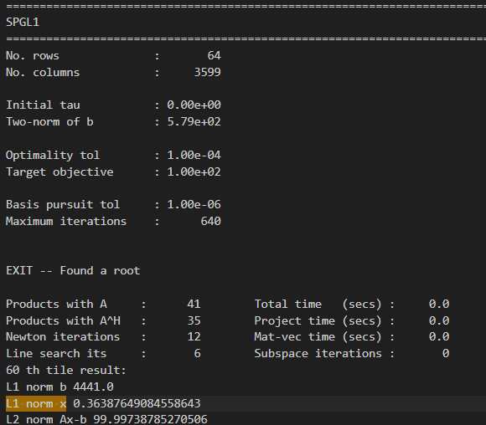
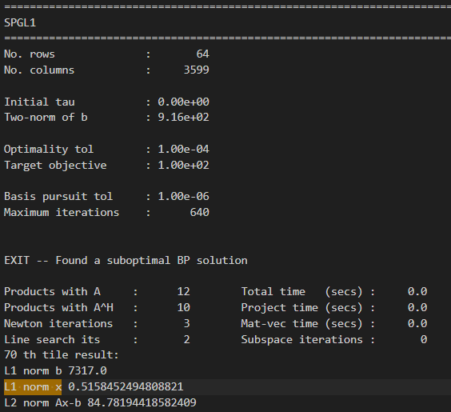
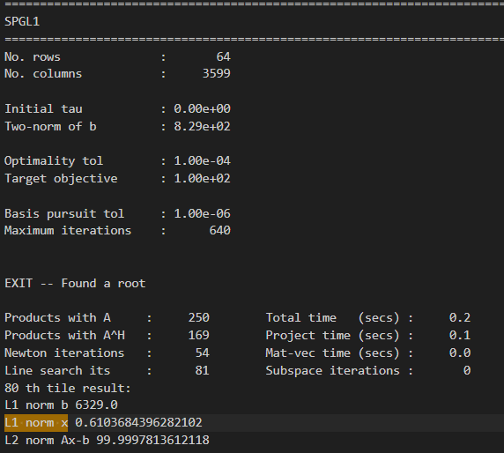

Slide 27
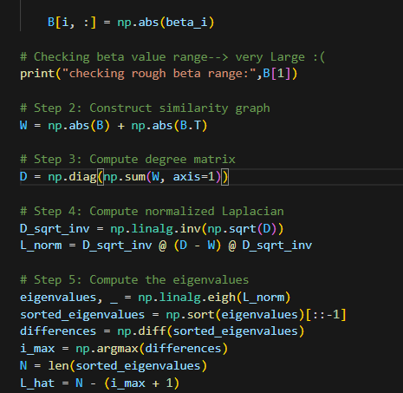
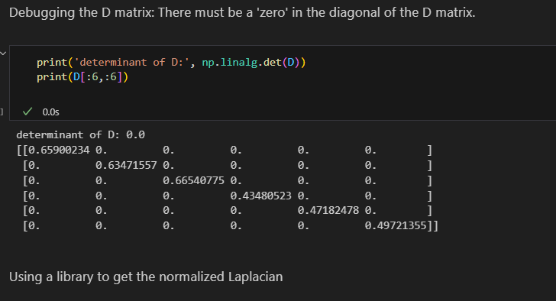
With this SPGL1_BPDN fitting for B, we find W.
Then realised that the Diagonal matrix has zero determinant => an element of the diagonal should be zero. That means that the degree of some of the nodes is zero.
Will that be a problem?
It might be-
Suspects:
When I bypass this singular D and use a module to handle it, I get the weird results down the line, at the L_hat (number of clusters) calculation. Maybe I’m just messing up in the Spectral Clustering.

Slide 28
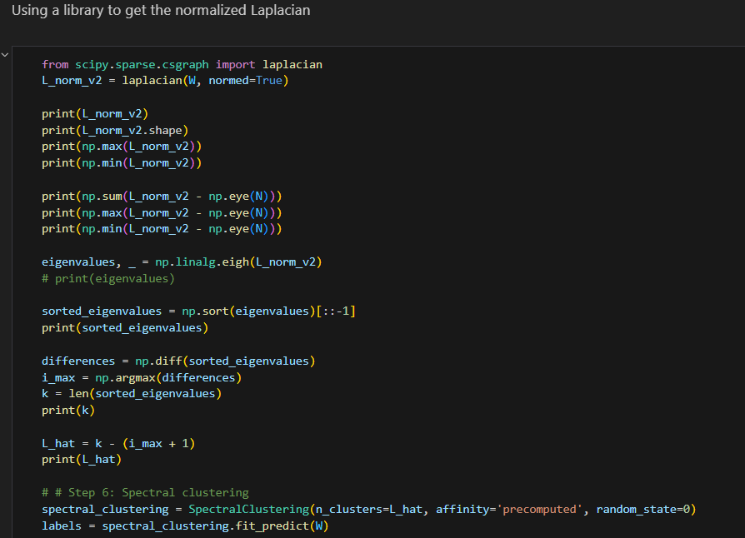
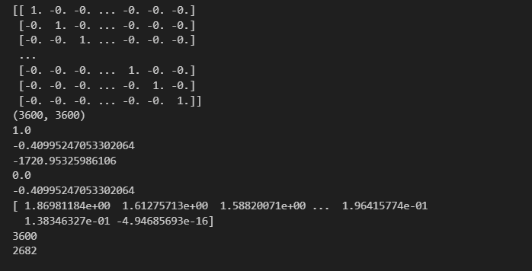

Slide 29
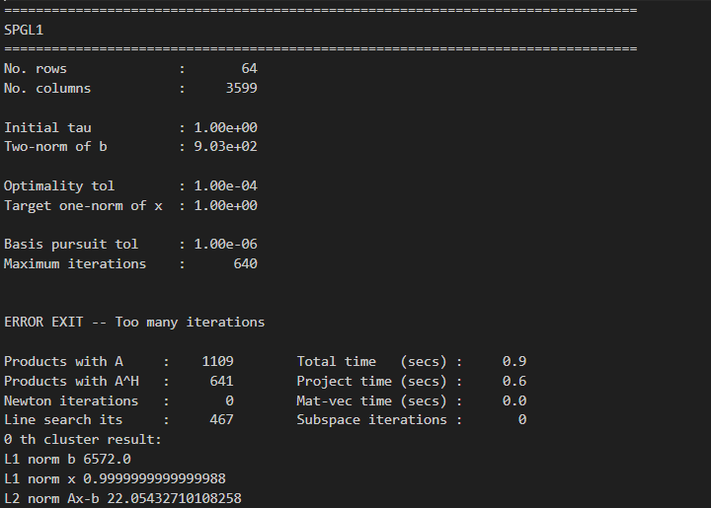
Tried the spgl1 solver: LASSO
With tau =1

Slide 30
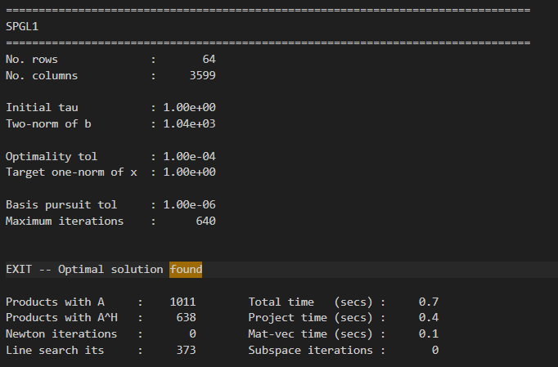
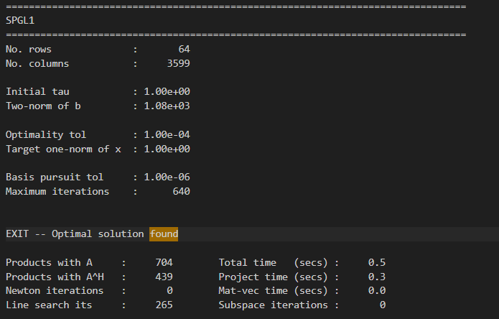
Optimal Solutions found in Blocks 21,22… and 138 other blocks out of the 3600 blocks.

Slide 31
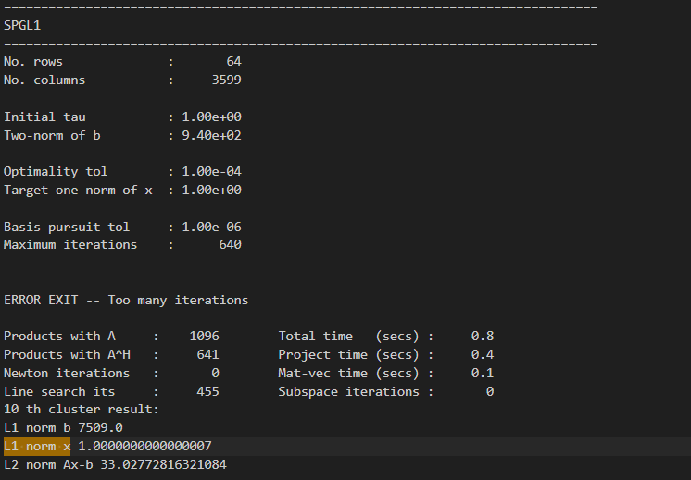
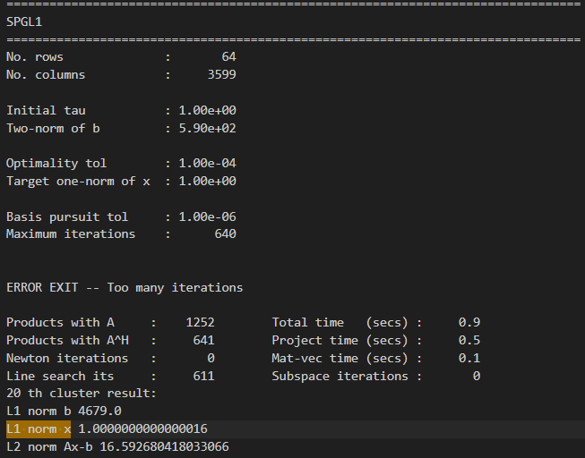
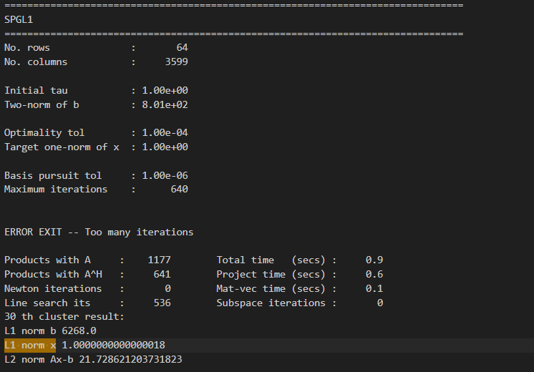
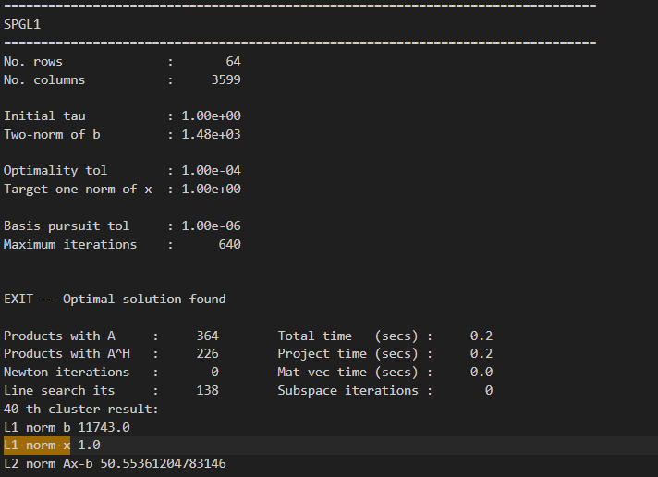

Slide 32
Comparison of the same tile number

Slide 36
End of June

Slide 37
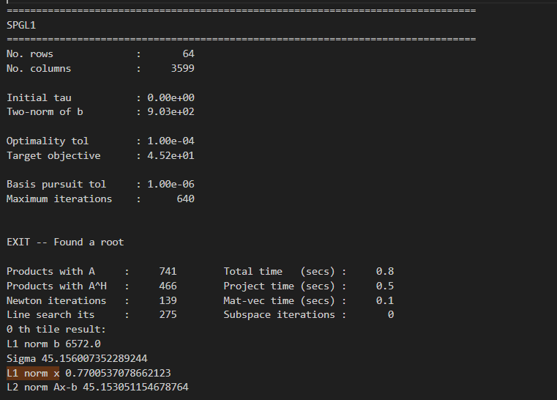
For BPDN, what if we change sigma for each patch?
Looks like the \sigma constraint makes the solution such tha |Ax-b| ~ sigma

Slide 38
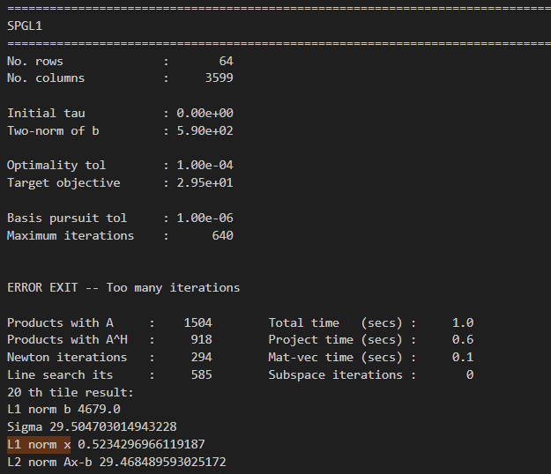
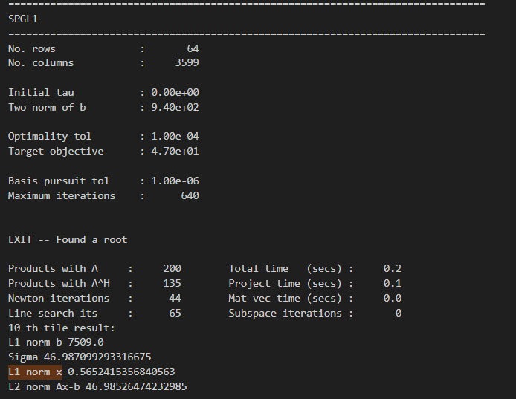


Slide 39
Comparison of the same tile number

Slide 42
Spectral Clustering performance
Slowly getting a full downstream code going.
Fixed the NAN problem with the clustering algorithm→ Need the similarity matrix as the input for the scipy clustering function
The NAN problem was fixed. It was due to a bug in the code. Clustering should be done with the similarity matrix.

Slide 43
Discussions in July, Early August - Trying to understand SPGL1 clustered results

Slide 44
The following slides have experiments starting from SPGL1.
Targeting for the paper: Deadline Sep 9

Slide 45





SPGL1_BPDN(not affine) compared to ElasticNetCV(Induced affine)
Parameters tuned to get a “desirable”* convergence:
sigma = 0.05 * np.linalg.norm(b, 2)
*- A ‘small’ || Ax_hat -b ||, A search with a solution to most patches
Parameters tuned to get “desired” convergence:
𝜶 = 5.8 (tuned until |x|~1)
𝝺 = 1
A typical Convergence looks like:
A typical Convergence looks like:

Slide 46


How many clusters are suggested by Robust SSC? :
512
How many clusters are suggested by Robust SSC? :
510 But this varies 470- 520 range when adjusting 𝜶.
Similarity matrix visualised. It is a symmetric matrix. Each row(column) is a solution to the optimization problem: trying to “match” each patch to all other patches.

Slide 48


The first slice of 256 rows from the top left
The first slice of 256 rows from the top left

Slide 49




patches giving high similarity index to other patches:
Patch 3
Patch 7

Slide 50


The top 3 patches with highest similarity visualised:

Slide 51

Compared “interesting” patches:
patch numbers [10,300, 330]

Slide 52



Patch no.10:

Slide 53




Slide 54
Experiments.. Focusing on how close we get to enforcing affine-ness, instead of focusing the comparison on the specific sparse approximation algorithm used.
Sep 1,2:

Slide 55
Experiment 1: Numerical results comparing 3 approaches
Image 𝔁 + Gaussian Noise
Non Overlapping tiles
Sparse approximation
PCA based reduction of each cluster to top 50% of PCA vectors,
Approximate
\hat{𝔁}
Candes, algorithm for no. of clusters, and spectral clustering
 | SPGL_BPDN | SPGL_LASSO | ELASTICNet_CV
Objective:
How is Affineness enforced? | Not enforced | Indirectly , Can achieve Σ|𝛃i| = 1 at converging solution by setting 𝛕=1 | Indirectly, try to tune 𝞪 s.t. Σ|𝛃i| = 1 But we enforce 𝛃i > 0
Achieving Σ𝛃i = 1? Need to tune parameters for it? | Not achieving Σ𝛃i = 1. Will five x such that ||Ax-b|| ~ sigma | Σ𝛃i = 1 in most patches. Σ|𝛃i| = 1 in all patches | Very hard to tune 𝞪 with noisy images. (Need to Change parameters with image, and noise level) Not achieving Not achieving Σ𝛃i = 1 for most patches
Number of predicted Clusters | 849 (image has 1024 patches) | 247 (image has 1024 patches) | 448 (unstable with 𝞪)
PSNR ( \hat{𝔁}, 𝔁) | 22.59 | 22.66 | 22.77 (unstable with 𝞪)
SSIM ( hat{𝔁}, 𝔁 ) | 0.344 | 0.346 | 0.348 (unstable with 𝞪)

Slide 56




The Numerical values of the above table was obtained using the cameraman image.
X + Gaussian Noise with std = 20 Pixel data range is (0,255)
SPGL_BPDN
SPGL_LASSO
ELASTICNet_CV
All methods have some trade-off which restricts us from directly enforcing all affine- constraints. SPGL_LASSO came the closest to satisfying the affinities constraint.

Slide 57



The Numerical values of the above table was obtained using the cameraman image.
SSIM Map of reconstructed image:
Using 849 clusters
SSIM Map of reconstructed image:
Using 247 clusters
SSIM Map of reconstructed image:
Using 448 clusters
All methods are really good at identifying the “outline” of the image. (SSIM =1 blocks) SPGL_LASSO (which came the closest to affinities)..did this more efficiently

Slide 58
Sep 5,6:
Brain storming
Should I make the patch size bigger?
Currently I have 8,8
Try 16,16
Change the L_hat parameter and see if the clustering gives better performance in clustering..
Then denoising.
⇒ As long as we can show Affine-ness works better.

Slide 59

Experiment 2: Overlapping patches for more data
Subexperiment: stride 4 px, patch size (8px ,8px)
This had ~9000 patches of data created.
Time taken for 9000 patches: 6 hrs
Looks like overlapping patches does not help.
Maybe our overlapping is not enough?
But we need more space.
I’m running other versions with smaller strides on Unity to check if this is still the case.
L_hat = # of predicted clusters ~ ⅓ of total # of data patches

Slide 60
Results of overlapped clustering
with SPGL_Lasso + Sankoltanobi method for predicting number of clusters
Overlapped SPGL Lasso, Image 3: Cameraman
Overlapping version | Total no. of patches from the image | Predicted no. of clusters | PSNR of denoised image with σ=20
Tilew8, stride 4 | 3969 | 1398 | 23.36
Tilew16, stride 4 | 3721 | 2005 | 23.37
Tilew16, stride 16 | 256 | 91 | 22.58

Slide 61
Overlapping also didn’t work
When the number of patches were increased by allowing overlappings to happen, we saw that the estimated number of clusters (L_hat) were on the scale of ~(⅓- ¼ ) of the total number of clusters.
This meant that the “Robust Subspace Clustering” algorithm given by Sankoltanobi et al (2014) is not “working” with the images we have. We suspect that their approach of “ordering the eigenvalues of the similarity matrix” is unreliable. (No clear drop off, as we saw in the J-curve method).
So can we still use a similarity matrix based on our different versions of sparse coefficient approximation, but yet try to fix the #of clusters L_hat = 20?
(because having 20 clusters worked well for kmeans)

Slide 62
Experiment 2: Enforce Number of clusters= 20. comparing 3 approaches of Generating the Similarity matrix of the spectral clustering.
Image no 3: Cameraman, Noise σ= 20, No overlapps
 | SPGL_BPDN | SPGL_LASSO | ELASTICNet_CV
Objective:
How is Affineness enforced? | Not enforced | Indirectly , Can achieve Σ|𝛃i| = 1 at converging solution by setting 𝛕=1 | Indirectly, try to tune 𝞪 s.t. Σ|𝛃i| = 1 But we enforce 𝛃i > 0
Achieving Σ𝛃i = 1? Need to tune parameters for it? | Not achieving Σ𝛃i = 1. Will five x such that ||Ax-b|| ~ sigma | Σ𝛃i = 1 in most patches. Σ|𝛃i| = 1 in all patches | Very hard to tune 𝞪 with noisy images. (Need to Change parameters with image, and noise level) Not achieving Not achieving Σ𝛃i = 1 for most patches
Enforce #Clusters (L_hat)= 20 | 20 (image has 1024 patches) | 20 (image has 1024 patches) | 20 (image has 1024 patches)
PSNR ( \hat{𝔁}, 𝔁) | 22.942 (22.59 when 849 clusters) | 23.58 (22.66 when 247 clusters) | 23.05(22.77 when 448 clusters)
SSIM ( hat{𝔁}, 𝔁 ) | 0.347 (0.344 when 849 clusters) | 0.352 (0.346 when 247 clusters) | 0.347(0.348 when 247 clusters)
All methods have some trade-off which restricts us from directly/exactly enforcing all affine- constraints. SPGL_LASSO came the closest to satisfying the affinities constraint, and does better than the other methods when denoising. The improvement is markedly better when a low no. of clusters are enforced.

Slide 63
Experiment 3: Trying to see if more noise levels give us a clearer picture: σ= 50
Image no 3: Cameraman, Noise σ= 50, No overlaps
 | SPGL_BPDN | SPGL_LASSO | ELASTICNet_CV
Enforce #Clusters (L_hat)= 20 | 20 (image has 1024 patches) | 20 (image has 1024 patches) | 20 (image has 1024 patches)
PSNR ( \hat{𝔁}, 𝔁) | 15.27 (22.942 when σ=20) | 15.73 (23.58 when σ=20) | 15.19 ( 23.05 when σ=20)
SSIM ( hat{𝔁}, 𝔁 ) | 0.191 (0.347 when σ=20) | 0.195 (0.352 when σ=20) | 0.191 (0.347 when σ=20)

Slide 64



PSNR/SSIM for image reconstruction with 20 clusters: Image 3: Cameraman
 | σ= 5 | σ= 10 | σ= 20 | σ= 30 | σ= 40 | σ= 50
SPGL_BPDN | 31.78/0.595 | 28.49/0.466 | 22.94/0.347 | 19.41/p.276 | 16.91/0.228 | 15.27/0.191
SPGL_LASSO | 33.21/0.608 | 29.16/0.475 | 23.58/0.352 | 20.04/0.278 | 17.45/0.227 | 15.73/0.195
ELASTIC_Net | 32.24/0.591 | 28.90/0.473 | 23.05/0.347 | 19.59/0.277 | 17.14/0.229 | 15.19/0.191
SSIM Map of predicted vs actual image: see that the prediction in terms of SSIM for “flat” regions
Approximated image at σ= 10

Slide 65


Slide 66
Experiment 4: Visualising each cluster: SPGL LASSO
Number of Clusters = 20
Cluster 0
Cluster 1

Slide 67
Cluster 2
Cluster 3
Cluster 4
Cluster 5
Cluster 6
Cluster 7
Example of clusters with only 2 patches

Slide 68
Cluster 8
Cluster 9
Cluster 10
Example of clusters with only 2 patches
Cluster 11
Cluster 12
Cluster 13
Example of a cluster with only 2 patches

Slide 69
Cluster 14
Cluster 15
Cluster 16
Example of a cluster with only 2 patches
Cluster 17
Cluster 18
Cluster 19
Outliers from visual inspection

Slide 70

Table for paper: Cameraman, How many patches in each cluster

Slide 71
Do the same visualisation for a non- affine case:
SPGL_BPDN: To try and visualise if the clustering is worse…. YES IT IS !!

Slide 73
Verify if there are blank clusters spread in all patches: verified by looking at the next clustering and n of each cluster.

Slide 74

Do the same visualisation for a non- affine case:
SPGL_BPDN: To try and visualise if the clustering is worse

Slide 75
A different image can give a larger gap for affine vs non-affine algos?
Trying Images:
1(Fruits) ,6(Rice), 7(Rice) ,9(Tape holder)

Slide 76




PSNR/SSIM for image reconstruction with 20 clusters: Image 1: Fruits
 | σ= 5 | σ= 10 | σ= 20 | σ= 30 | σ= 40 | σ= 50 | σ= 100
SPGL_BPDN | 35.45/0.625 | 29.32/0.419 | 22.95/0.238 | 19.66/0.161 | 17.45/0.120 | 15.82/0.092 | 11.07/0.034
SPGL_LASSO | 35.62/0.634 | 29.32/0.420 | 23.33/0.249 | 20.05/0.169 | 17.83/0.124 | 16.23/0.096 | 11.39/0.036
ELASTIC_Net | 35.45/0.624 | 29.08/0.414 | 23.22/0.244 | 19.78/0.163 | 17.55/0.118 | 15.84/0.090 | 11.16/0.034
Approximated image at σ= 10
SSIM Map of predicted vs actual image: see that the prediction in terms of SSIM for “flat” regions
Noisy image at σ= 10

Slide 77





PSNR/SSIM for image reconstruction with 20 clusters: Image 6: Rice
 | σ= 5 | σ= 10 | σ= 20 | σ= 30 | σ= 40 | σ= 50 | σ= 100
SPGL_BPDN | 31.39/0.904 | 28.28/0.830 | 23.05/0.675 | 19.68/0.556 | 17.21/0.474 | 15.37/0.406 | 10.65/0.211
SPGL_LASSO | 32.27/0.908 | 28.43/0.832 | 23.07/0.677 | 19.75/0.561 | 17.49/0.481 | 15.73/0.416 | 10.97/0.220
ELASTIC_Net | 32.21/0.910 | 28.40/0.833 | 22.94/0.672 | 19.61/0.557 | 17.26/0.474 | 15.37/0.405 | 10.68/0.211
SSIM Map of predicted vs actual image: see that the prediction in terms of SSIM for “flat” regions
Approximated image at σ= 10
Noisy image at σ= 10

Slide 78





PSNR/SSIM for image reconstruction with 20 clusters: Image 7: Wheel
SSIM Map of predicted vs actual image: see that the prediction in terms of SSIM for “flat” regions
SPGL_LASSO Approximated image at σ= 10
Noisy image at σ= 10

Slide 79
PSNR/SSIM for image reconstruction with 20 clusters: Image 9: Tape Holder

Slide 80

Experiment 5: NLM in the denoising

Slide 81
Experiment 6: Seeing if more patches give higher scores across all 3 methods (when L_hat = 20 is fixed)
PSNR/SSIM for image reconstruction with 20 clusters:
Image 3: Cameraman, tile=8, stride=4
 | σ= 5 | σ= 10 | σ= 20 | σ= 30 | σ= 40 | σ= 50 | σ= 100
SPGL_BPDN
SPGL_LASSO
ELASTIC_Net

Slide 82
Plan on Tuesday: Let’s aim for 3 things:
NLM Baseline: Run a faithful reconstruction of NLM as a baseline. Compare it with the Patch Subspace Projection(PSP) approach [This is our `design’ of denoising within a cluster.
Look at the paper to find how to tune the parameters
Denoised Image comparisons of BPDN vs NCC LASSO vs NLM
The denoising step, to enforce the coefficient of the “mean basis” is 1: would affect the denoisisng of NCC_Lasso (spgl_lasso) and NC_Lasso (elasticnet)
Overall, lets get as much data as we can for the paper.

Slide 83

Denoising of clusters with Patched Subspace projection (PSP) in each cluster, compared to Denoising with NLM from scikit-learn package

Slide 84


Visually comparing the prediction of the denoised image: σ=5
NCC_Lasso (spg_lasso)
NLM( patch size= 8, window size = 250, h=0.01)
Comments: Take a BnW image, remove axis

Slide 85

Denoising of clusters with NLM in each cluster, compared to Denoising with NLM from scikit-learn package

Slide 86

Enforcing the mean projection =1 at PCA projection→ did not work :C

Slide 87

The reconstruction when \sigma=10 for meanenforced denoising after NNC Lasso clustering: Patchy behaviour….
Try overlapping
Try doing debugging the code.
The NLM looks too bad. (too good for us)
Maybe try adjusting the parameters more. At Least now we see some of our methods are also not working.

Slide 88

Enforcing the mean projection =1 at PCA projection→ did not work :C
Images in the next slide.

Slide 89






NLM
BPDN
NC_Lasso (Elastic net)
Images from the experiments in slide 86
σ=5
NNC_Lasso
Let me adjust NLM parameters more….
Should I push parameters until psnr is better? Or visually appealing?
No visual difference between BPDN, NNC_Lasso
σ=10

Slide 90

Artifacts for \sigma =5?

Slide 91








NLM
BPDN
NC_Lasso (Elastic net)
NCC_Lasso
σ=30
σ=50

Slide 92
Try in the future:
A histogram of patches to show the degree of affineness

Slide 93







Images in Grayscale without colorbar/axis
Noisy Image
NLM
BPDN
NC_Lasso (Elastic net)
NCC_Lasso
σ=5
σ=10

Slide 94





Noisy Image
NLM
BPDN
NCC_Lasso
σ=20
NC_LASSO (elasticnet)

Slide 95





Noisy Image
NLM
BPDN
NC_Lasso (Elastic net)
NCC_Lasso
σ=30
σ=50

